Slide 1


MCSA LAB

Slide 2
FIRST SERVER SETTING

Slide 3
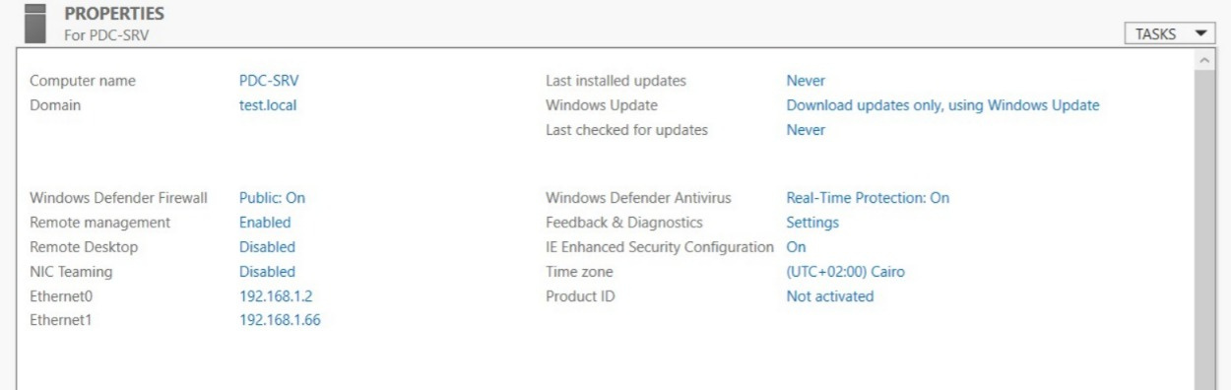
ADDS && INTIAL CONFIGURATION

Slide 4
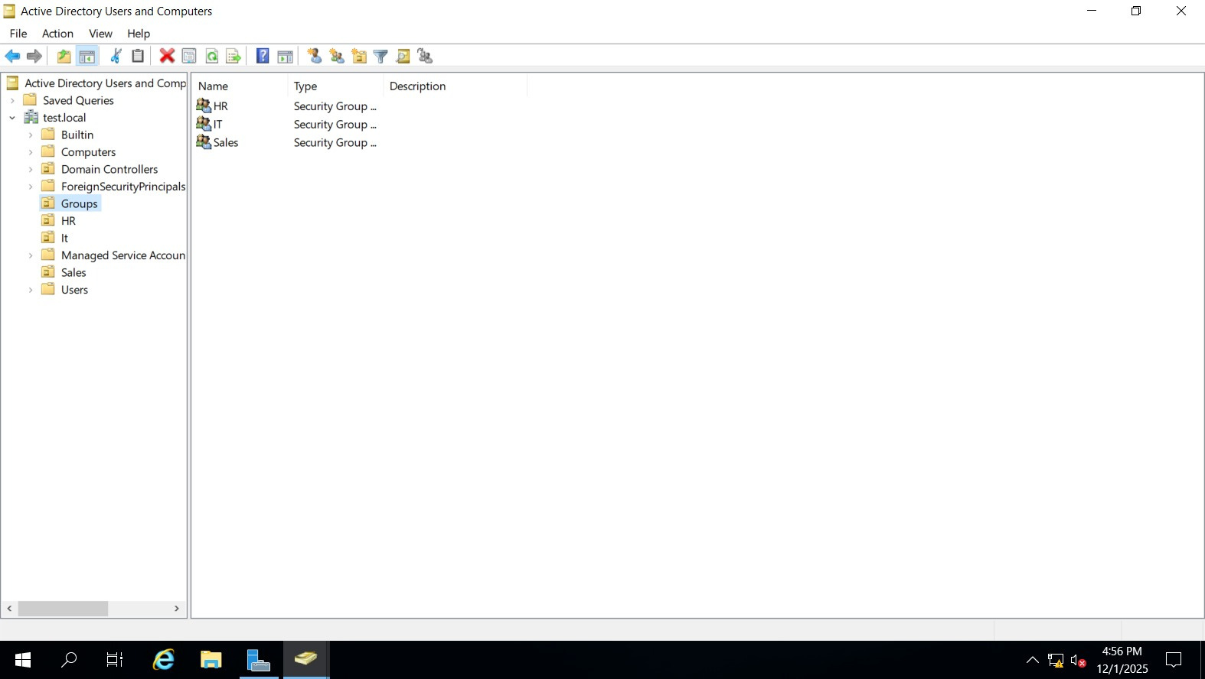
Create OUs for three department and three groups

Slide 5
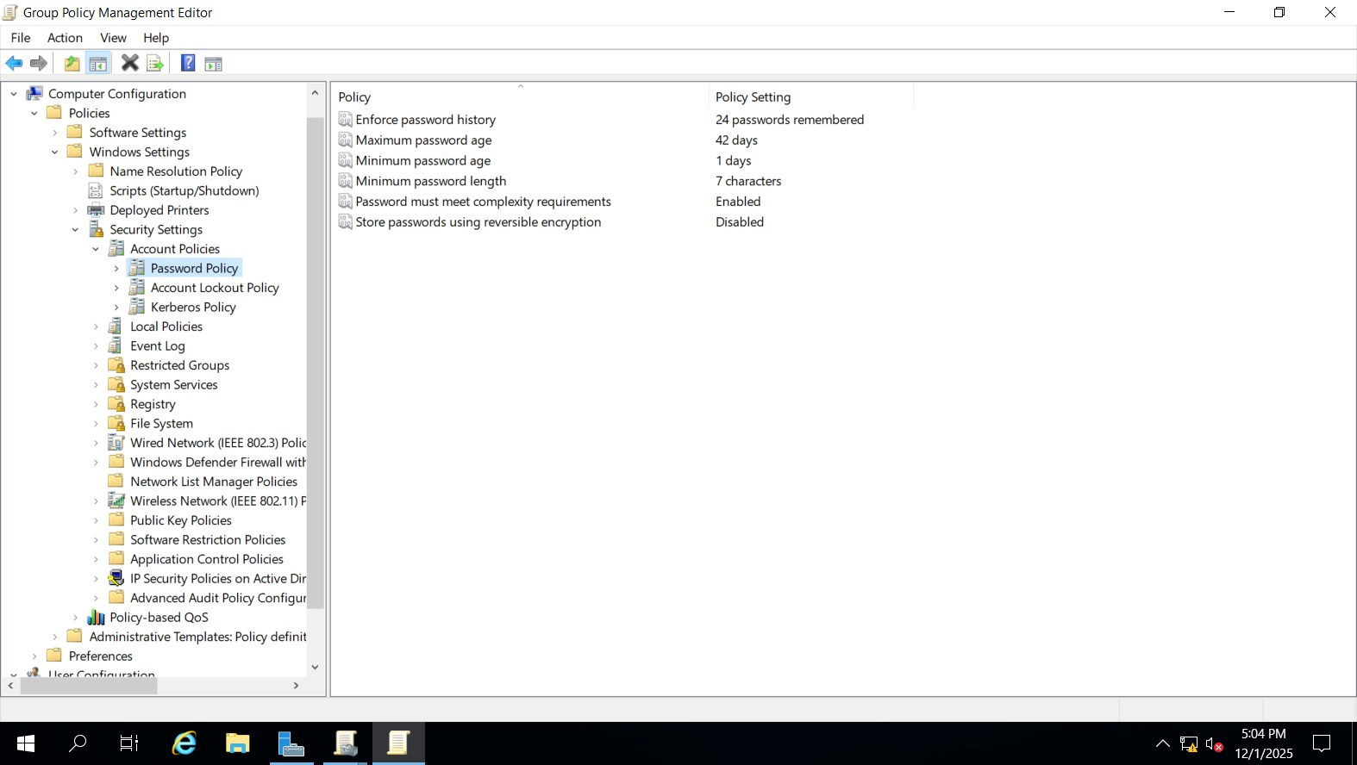
PASSWARD POLICY MANAGMENT

Slide 6
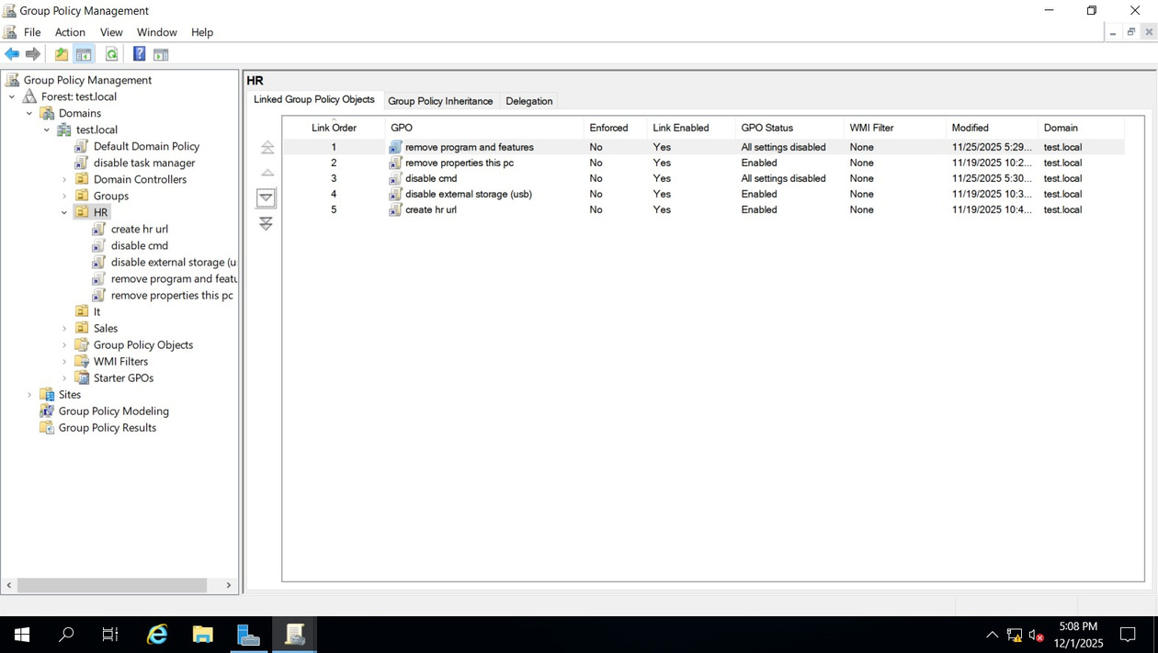
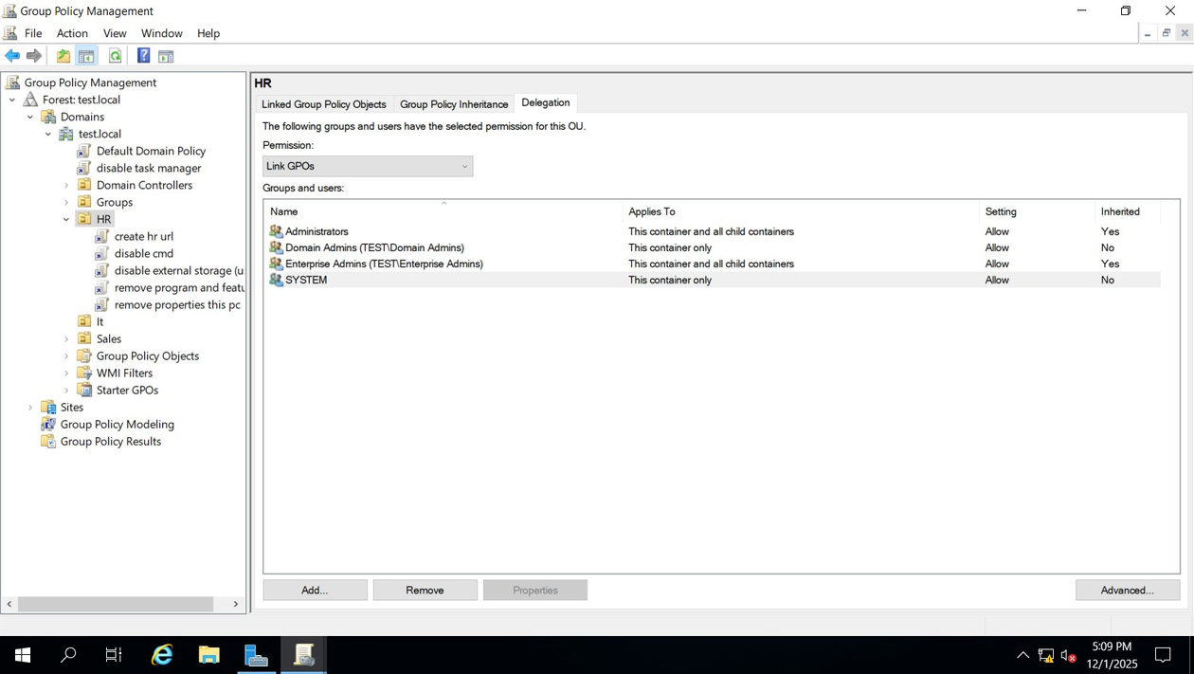
DIFFERENT POLICIES ON HR GROUPS

Slide 7
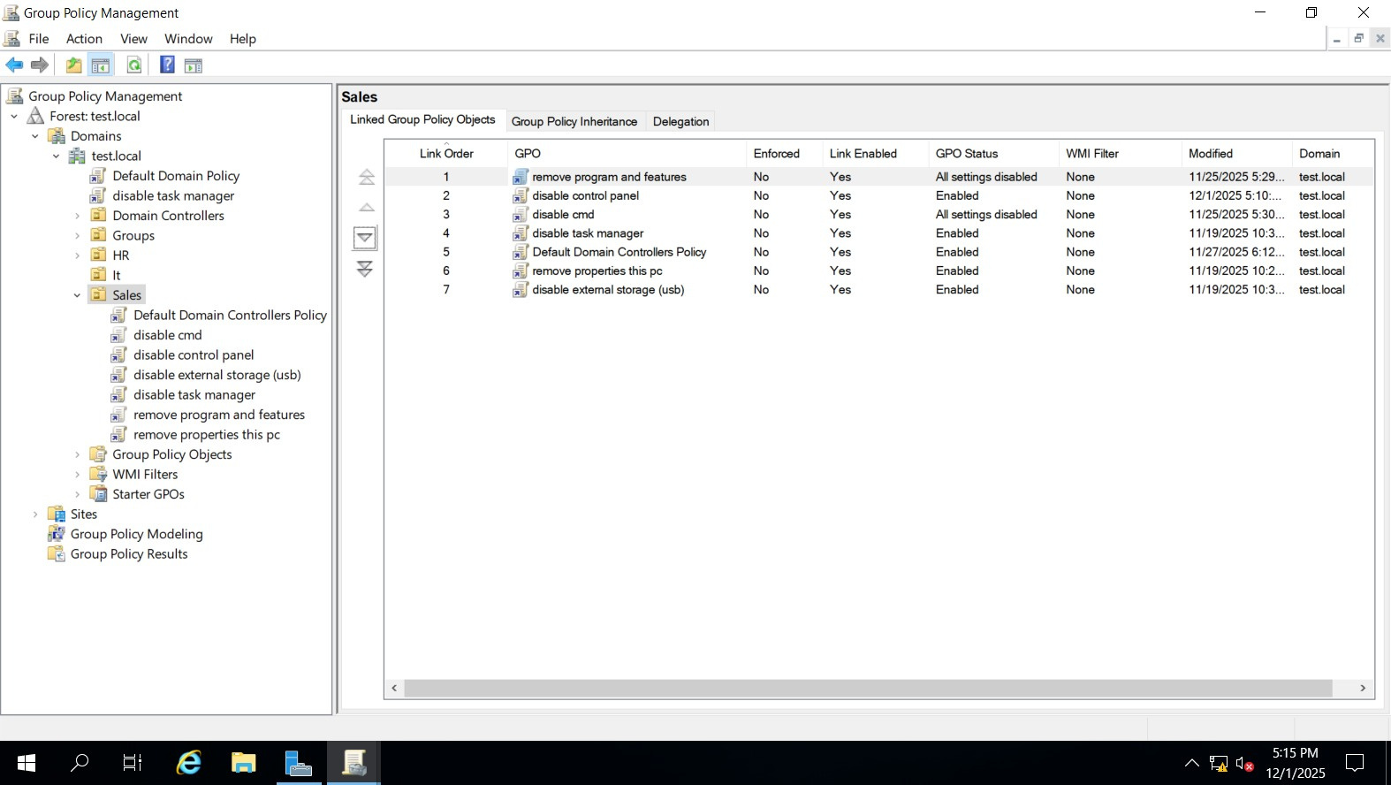
DIFFERENT POLICIES ON SALES GROUPS

Slide 8
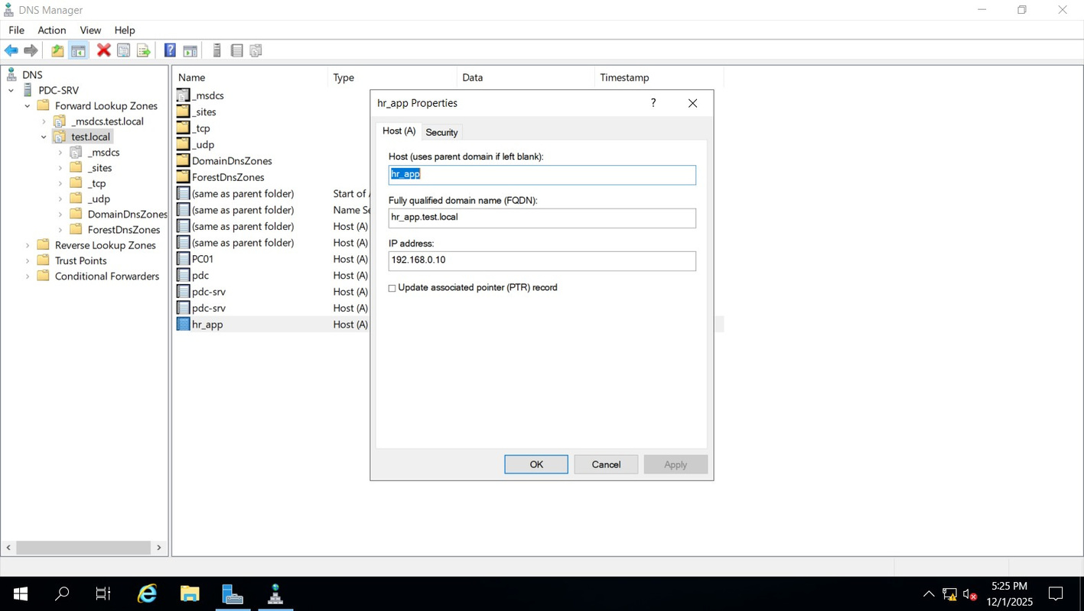
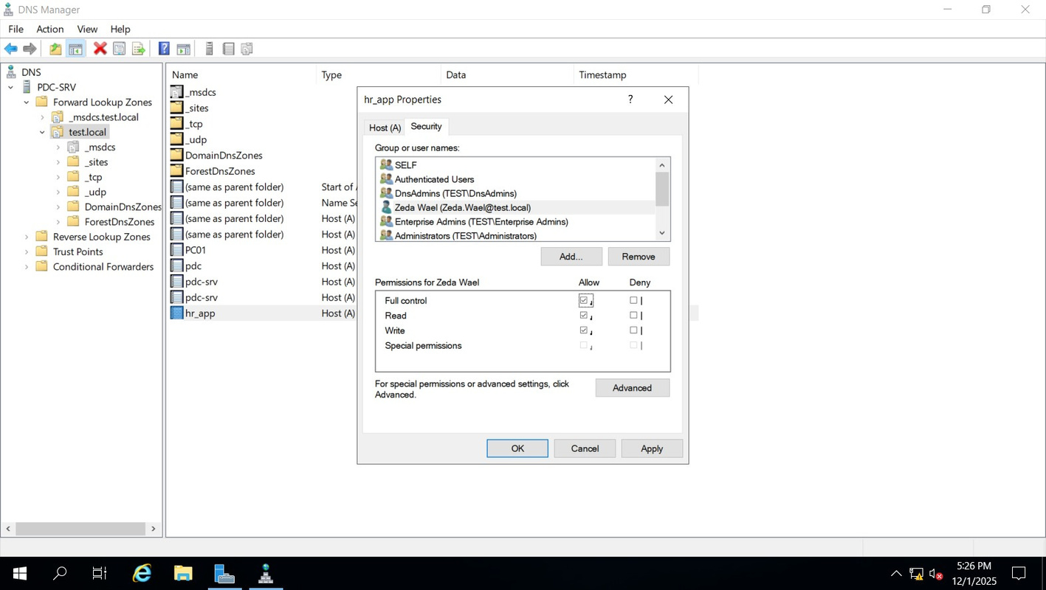
DNS RECORD

Slide 9
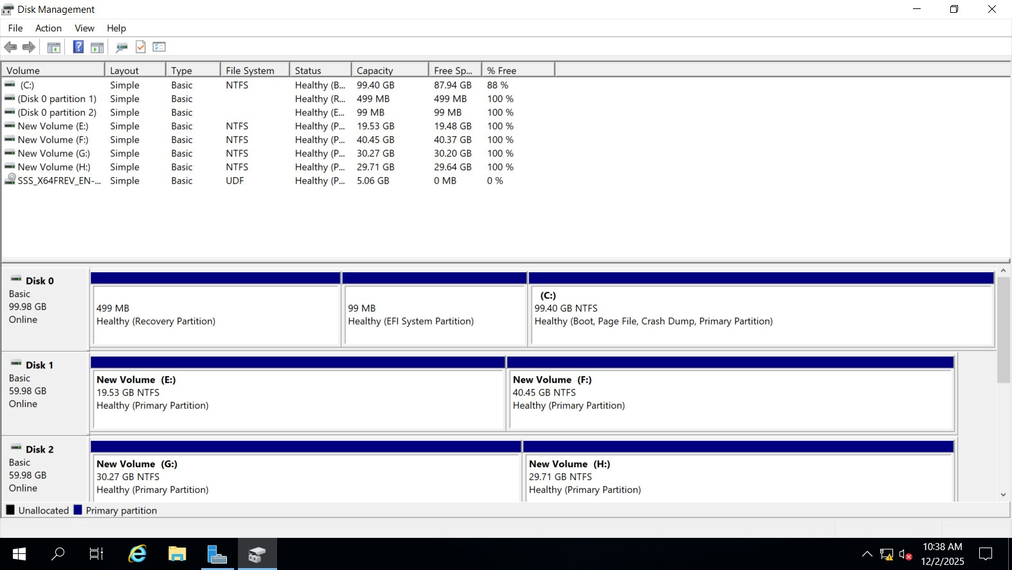
DISK MANAGMENT

Slide 10
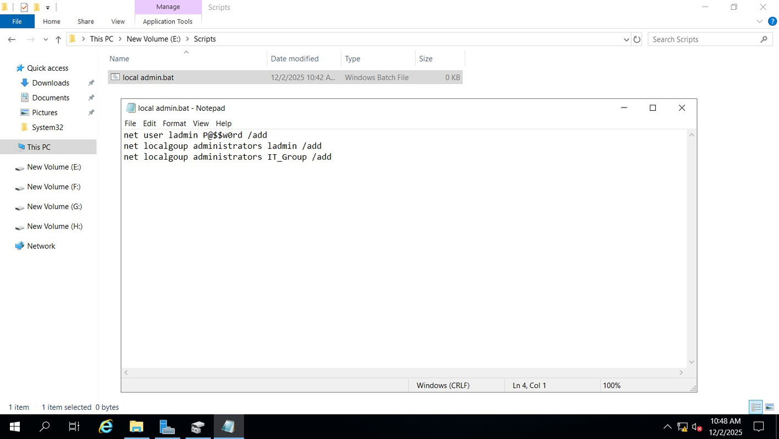
LOCAL ADMIN SCRIPT

Slide 11
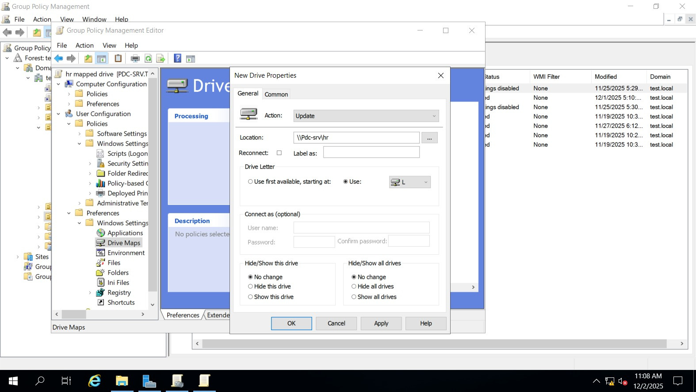
HR MAPPED DRIVE

Slide 12
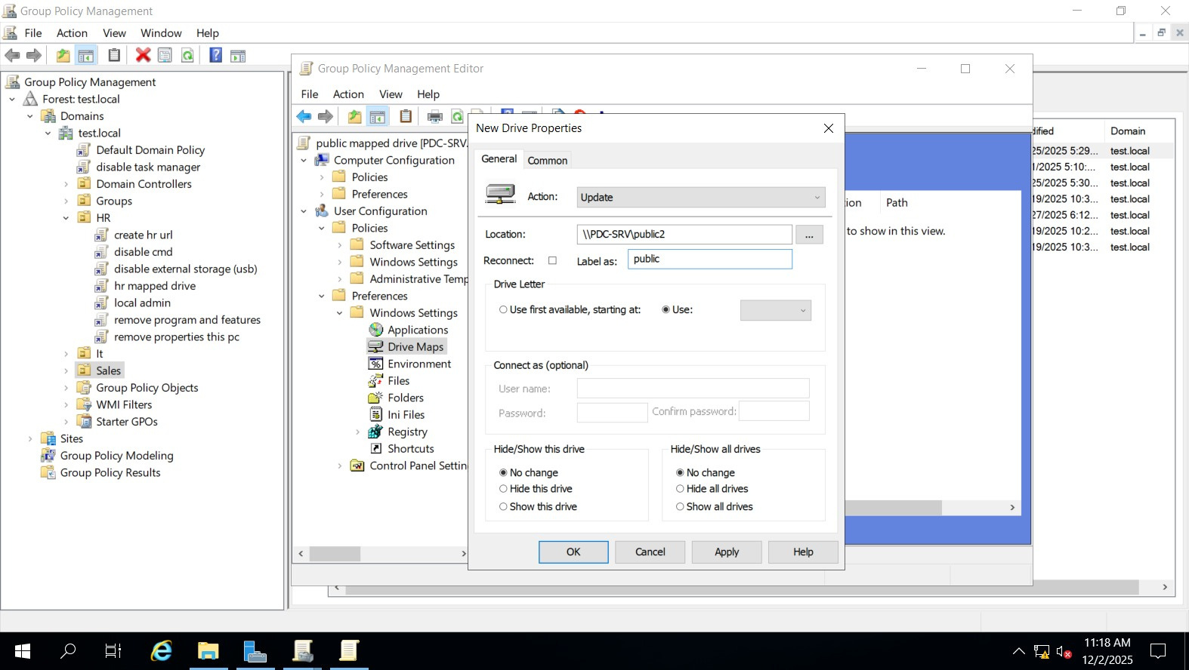
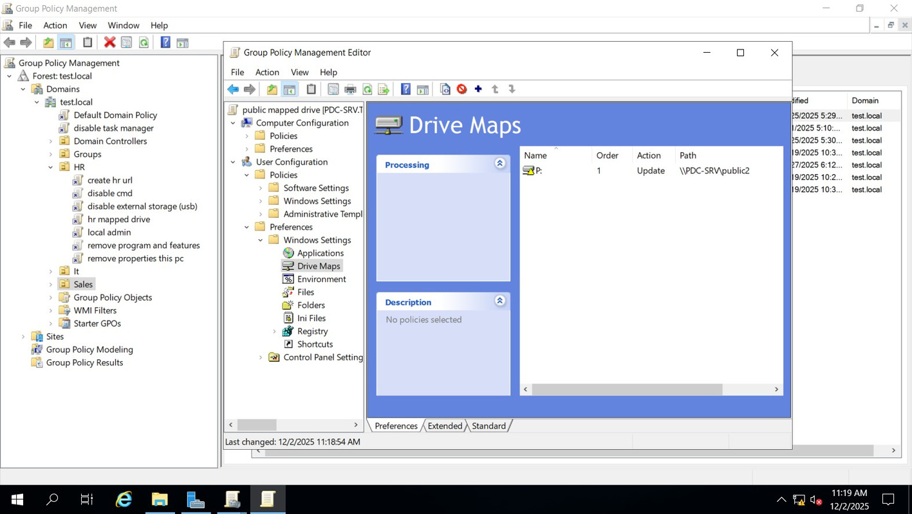
PUBLIC MAPPED DRIVE

Slide 13
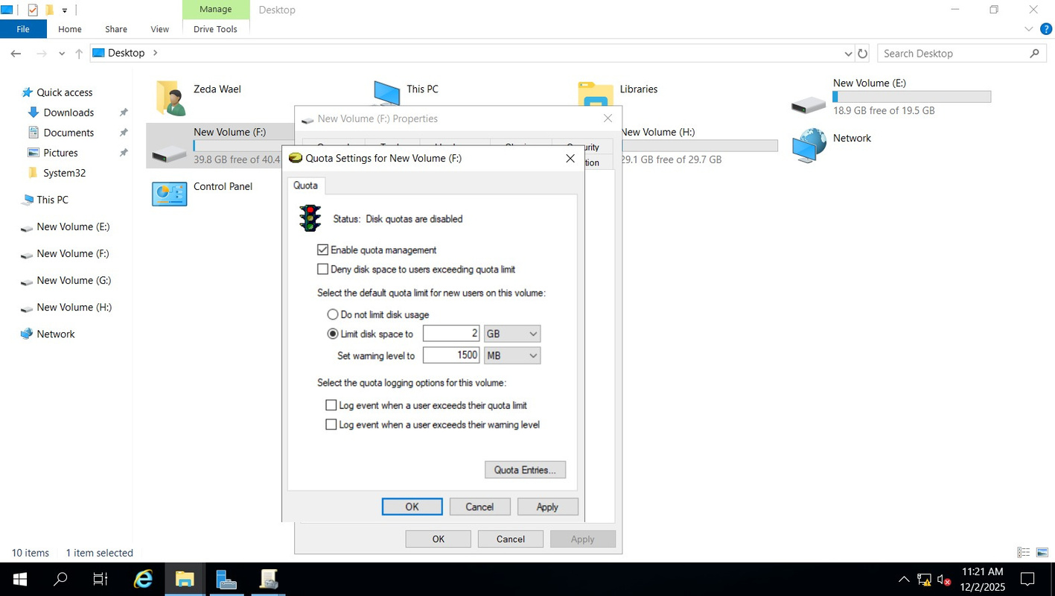
QOUTA 2GIB FOR PUBLIC MAPPED DRIVE

Slide 14
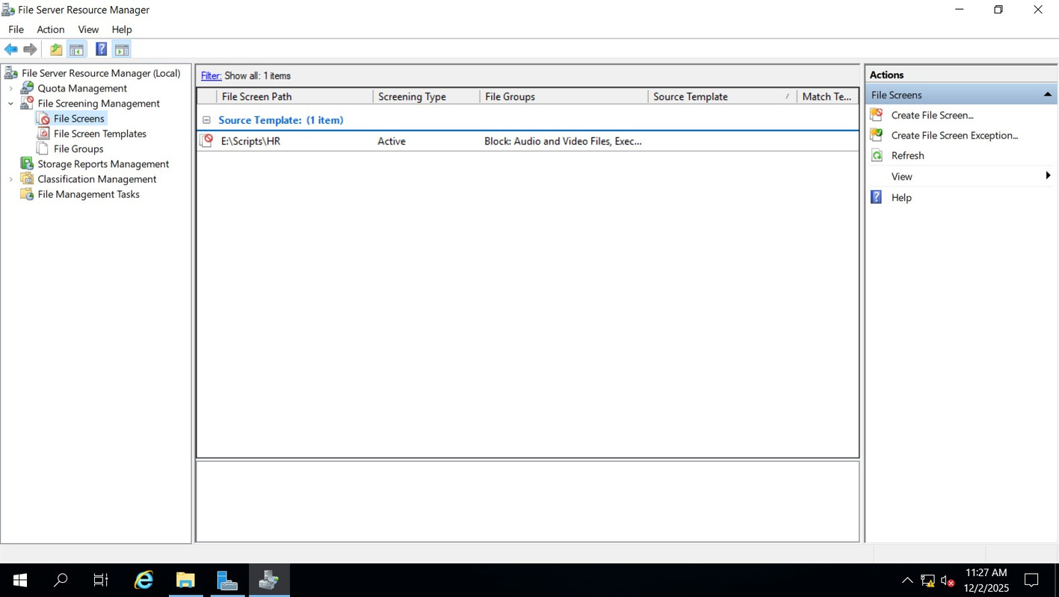
FILE SCREENING TO BLOCK THE AUDIO AND EXECUTABLE FILE

Slide 15
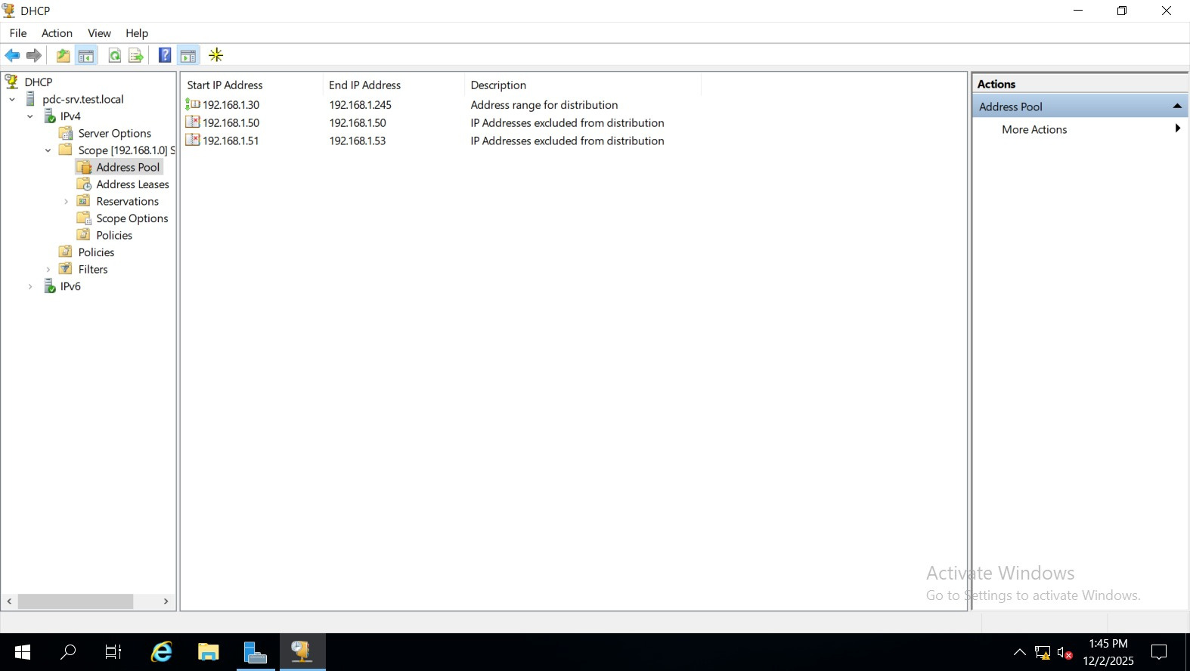
DHCP SCOPE

Slide 16
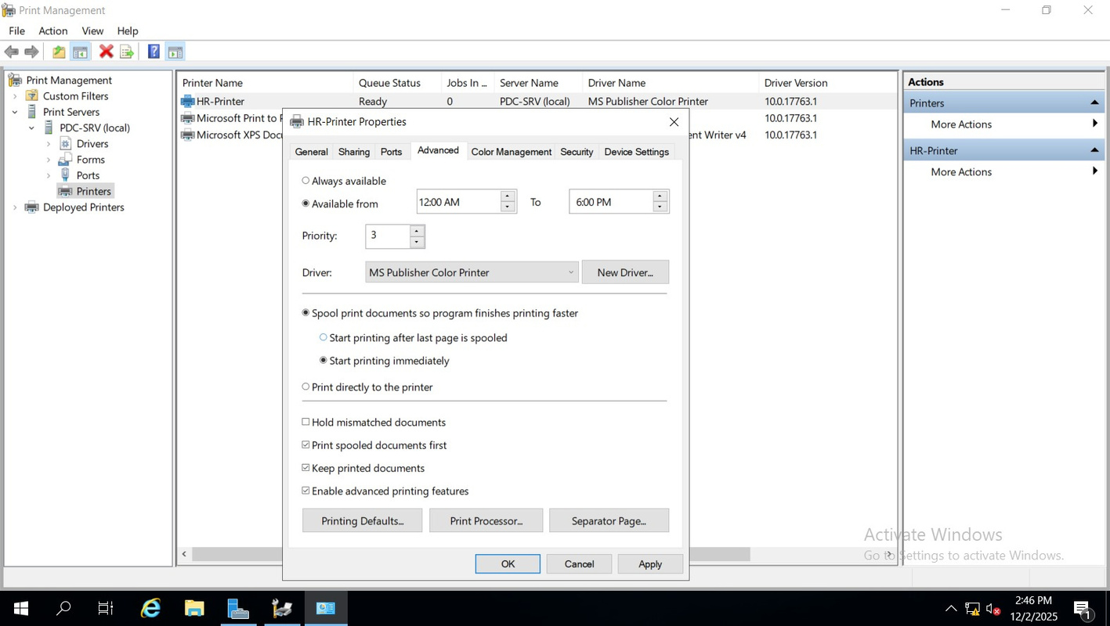
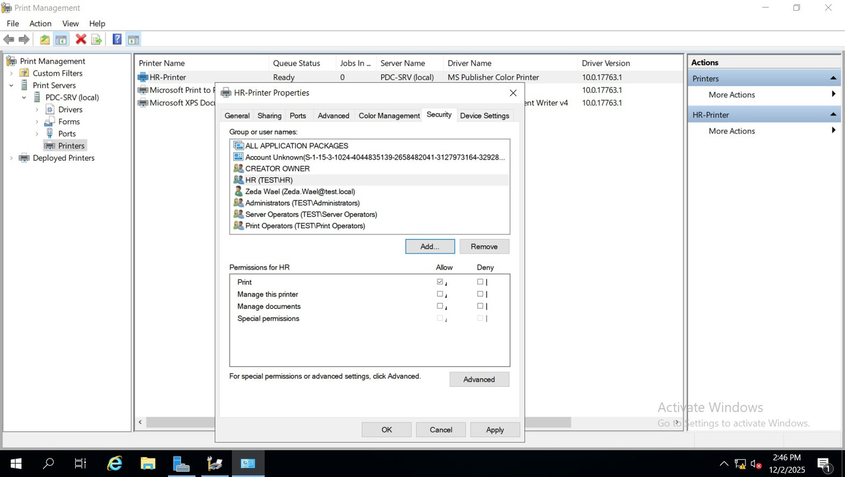
ADD HR-PRINTER && ITS SETTING

Slide 17
THEN CLIENT SETTING

Slide 18
INSTALLING ISO FROM SERVER WDS NOT NEED DVD OR EXETERNAL STORAGE

Slide 19
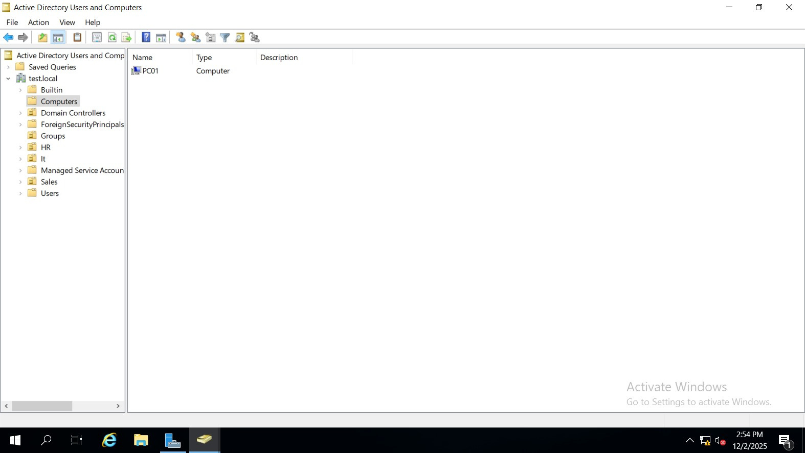
THE MACHINE IS JOINED TO DOMAIN

Slide 20
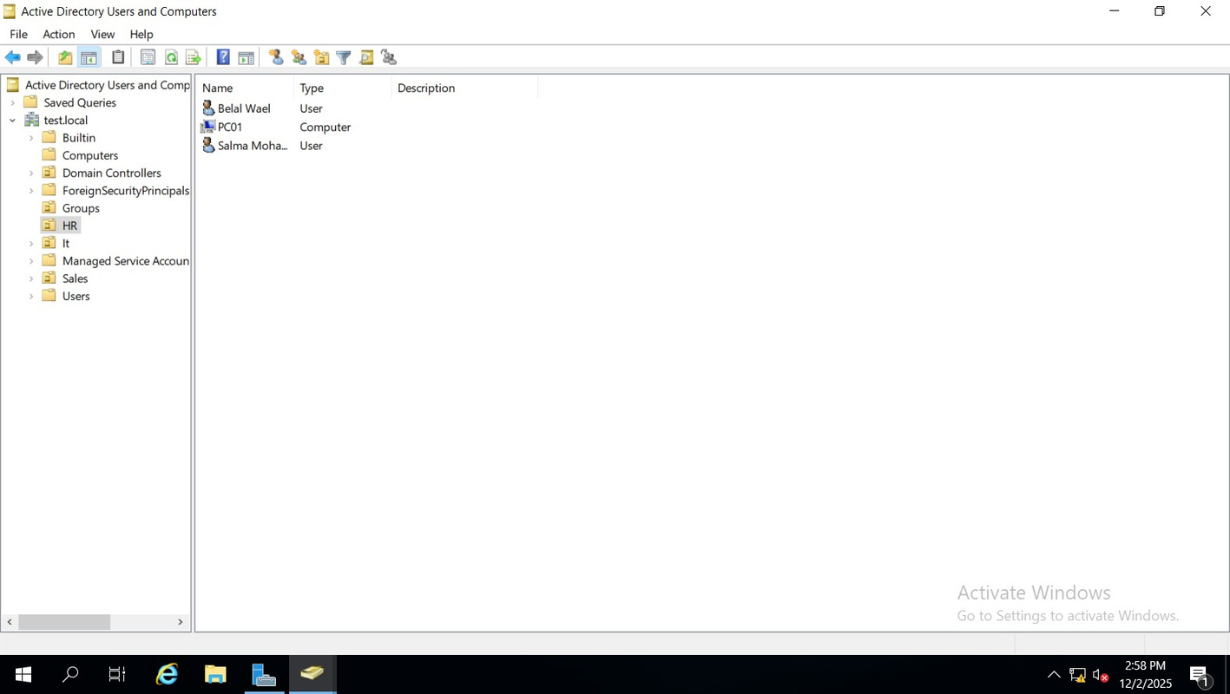
TAKE PC TO HR GROUP TO APPLY THE POLICES

Slide 21
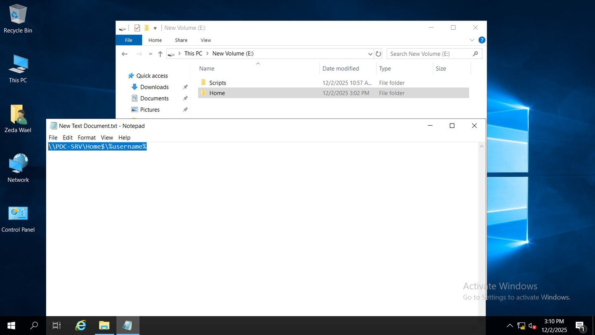
ADD HOME FOLDER

Slide 22
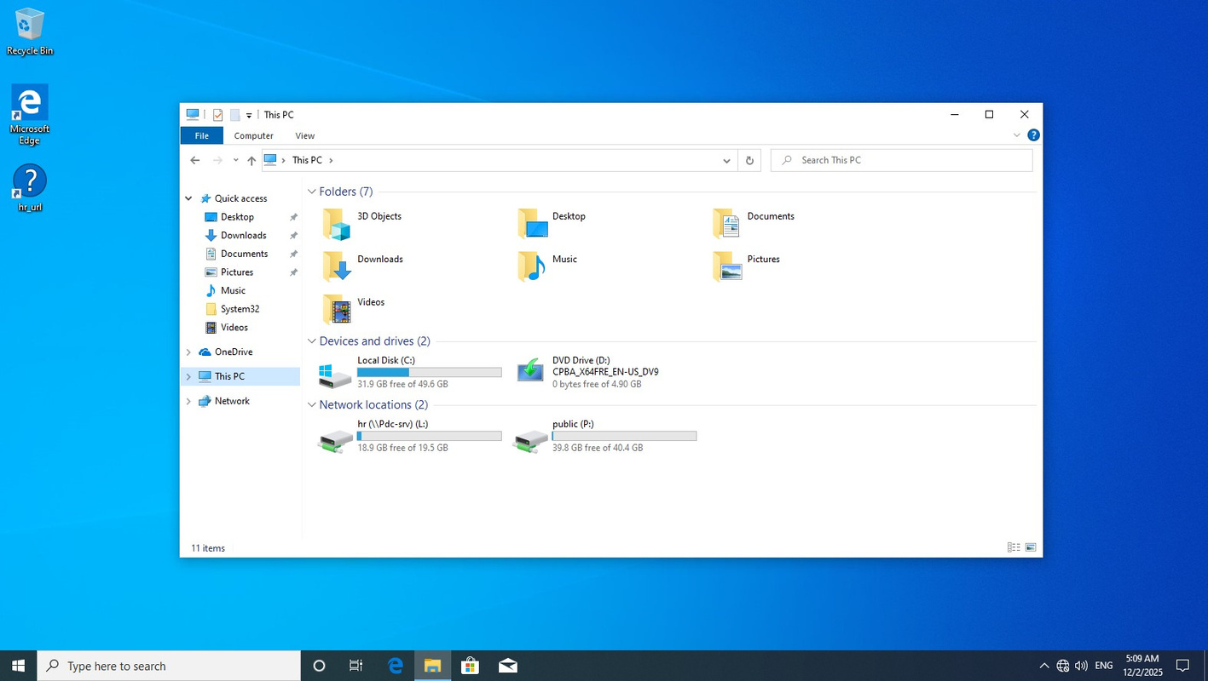
HR PC

Slide 23
BORCELLE
Home
Photo
About Us
Contact
WWW.REALLYGREATSITE.COM
THANK YOU

